Slide 1
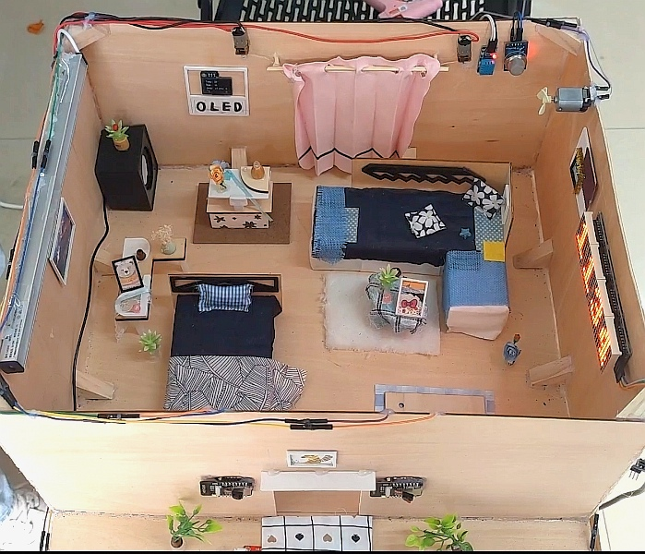
Dormitory intelligent assistant based on STM32
Team: Team 5
Team Member: Zhiyue Yin, Lurui Xie, Wenlu Yu, Peilin Ji,
Junyi Liu, Ruoting Liu

Slide 2
Application background & main functions
Contest
Speech recognition & control module
Bluetooth Module & the APP
Dot matrix screen & OLED screen
Camera monitoring & cloud platform
Other modules
Division of labor

Slide 3
Application background
& Main functions

Slide 4
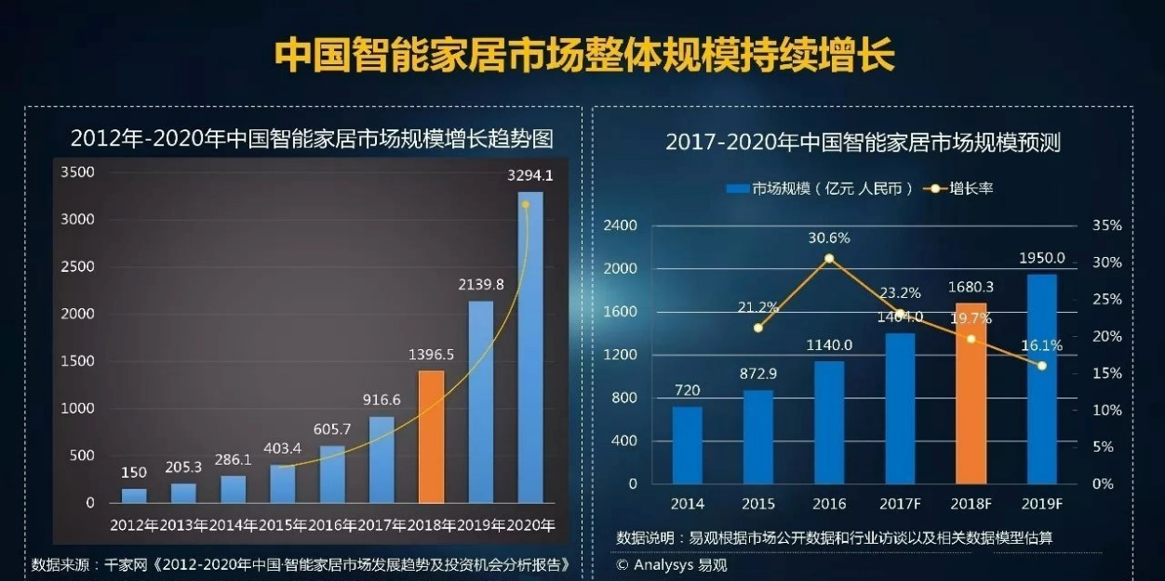

01
Application background
The rapid development of the smart home industry in China in recent years shows that people’s pursuit of quality of life is increasing day by day, especially the generation of young people who are constantly pursuing the convenience of dormitory life.
At present, more and more college students need a kind of intelligent household product which can improve the quality of life and bring allround convenience. This product came into being.

Slide 5
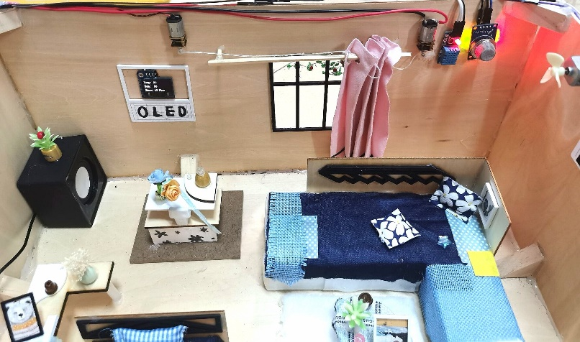
01
Main functions
Intelligent voice control
Normal mode
Defense mode
(1) Intelligent voice control: Intelligent voice assistants can be awakened by specific wake-up words, and specific instructions can be given to achieve corresponding functions after waking up. The functions that can be realized are: turn on & off the light, open & close the door, turn on & off the fan, turn on & off the curtain, and turn on & off defense modes.
(2) Normal mode: the OLED screen can real-time display humidity, temperature, air quality, and whether there are people staying outside the door, and this basic information of dormitory can be received and viewed in the mobile APP in real-time.

Slide 6
01
Main functions
(3) Defense mode: On the basis of the normal mode, you can also turn on the defense mode through the intelligent voice assistant. After the mode is turned on, in addition to the basic functions of the normal mode, the camera and pressure sensor will be activated. The camera can take a picture outside the door every 20 seconds and upload it to the cloud platform, allowing you to know the real-time situation outside the door through the APP anytime, anywhere. When someone is outside the door, the pressure sensor installed on the ground can quickly capture it, the camera intercepts a short video and sends a notification through the APP, and the user can take pictures of the person outside the door through the APP. When a suspicious person breaks in, the APP will immediately display an alert.
Intelligent voice control
Normal mode
Defense mode

Slide 7
Speech recognition & control module

Slide 8
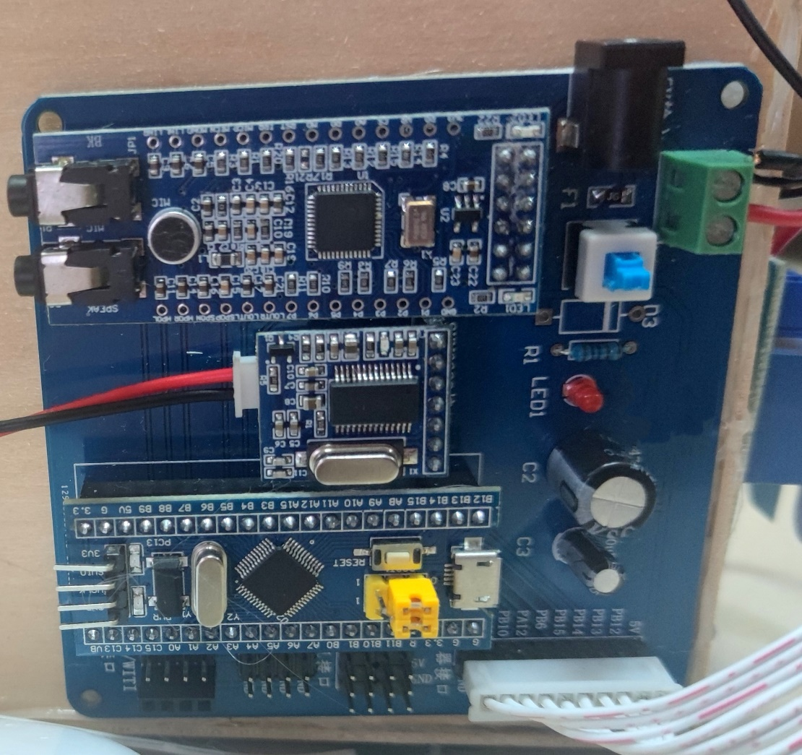
02
Speech recognition & control module
Implementation functions:
Through the voice recognition function to realize the opening and closing of the relay, and then realize the switch light, switch the fan, switch the curtain, switch the camera and switch the defense mode. Speech recognition includes first-level command and second-level command.
The first-level command is "Xiao Bei". After successfully recognizing the first-level command, the voice assistant will wake up and respond to "Wo zai".The second-level commands include ten commands such as "Da kai deng" and "Guan bi deng". When the voice assistant receives and recognizes the second-level commands, it replies with statements such as "deng yi da kai". In addition, if there is no second-level command within 20 seconds after waking up the voice assistant, the voice assistant will automatically shut down. If users want to shut down the voice assistant in advance, they can use the entry of "tui xia ba xiao bei" to operate.

Slide 9
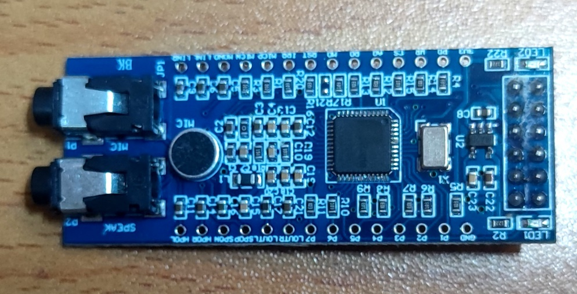
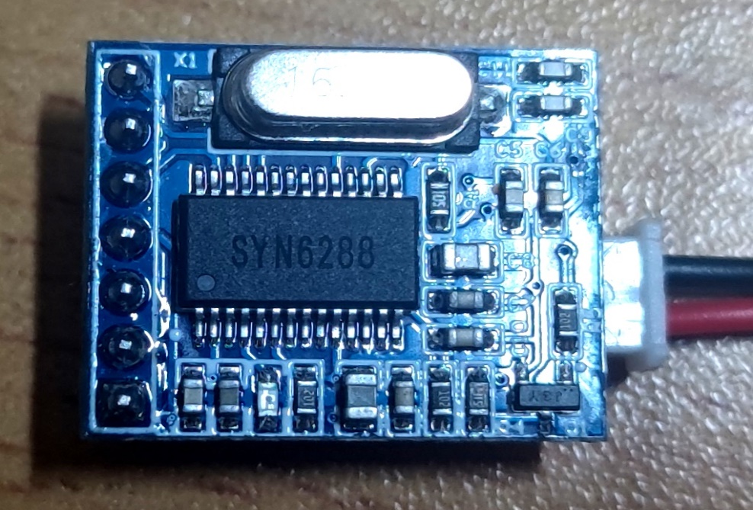
02
02
Speech recognition & control module
2. Chip introduction
The speech recognition and control module is based on LD3320 speech recognition chip and SYN6288 speech synthesis chip to achieve its functions.
LD3320 is a speech recognition function that separates Chinese characters into pinyin letters. It is a speech recognition chip based on non-specific voice recognition technology, that is, it can realize speech recognition without the user's recording training. At the same time, the key words list identified by the chip can be dynamically edited, allowing users to edit 50 key words freely.
SYN6288 Chinese speech synthesis chip converts received text data to Chinese speech through text analysis and processing algorithm.

Slide 10
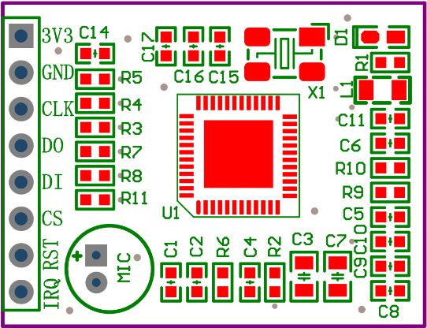
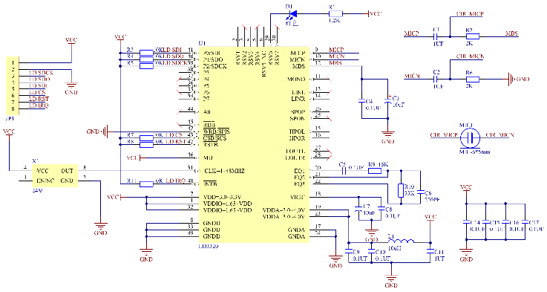
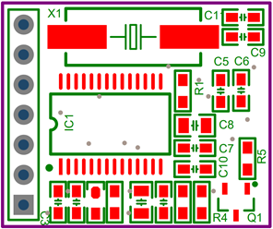
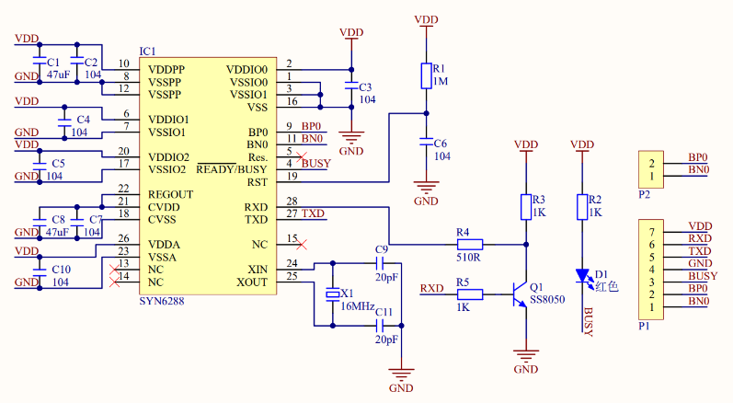
02
Intelligent voice control
LD3320 module schematic diagram
3. Discrete module circuit connection diagram
Through consulting the LD3320 and SYN6288 chip manual, on the basis of the typical application circuit, according to the actual circuit calculation and selection of component models, through Altium Designer to draw the LD3320 module schematic diagram and SYN6288 module schematic diagram and the corresponding PCB diagram. Send the PCB project to "Jie pei" mall to print the corresponding PCB board.LCD3320 module and STYN6288 module are completed by welding components on PCB board.
SYN6288 module schematic diagram

Slide 11
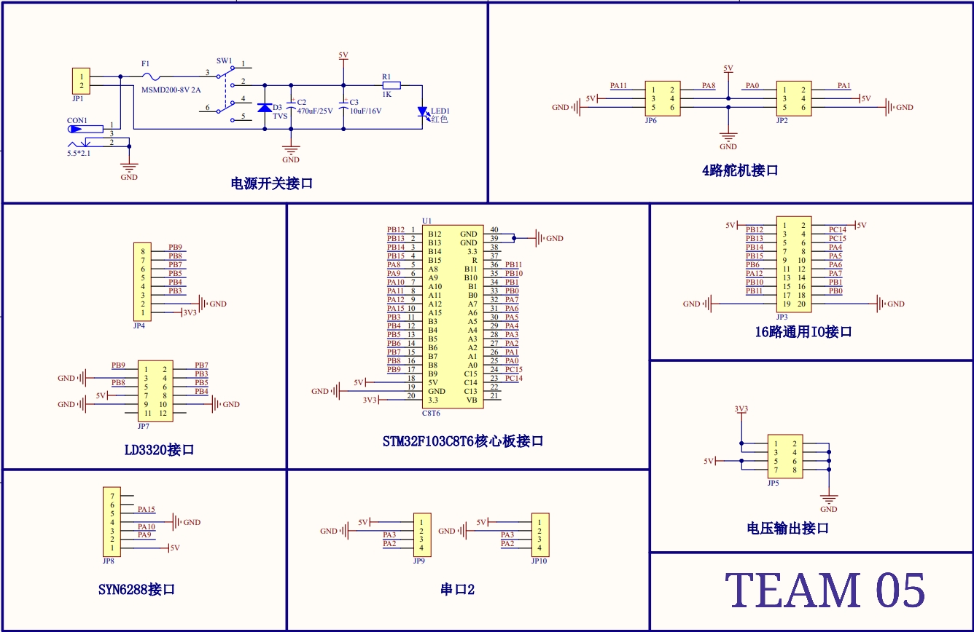
02
Intelligent voice control
4. The speech recognition and control system is designed by assembling and welding SYN6288, LD3320 and STM32F103C8 system boards together.

Slide 12
Bluetooth Module
& the APP

Slide 13
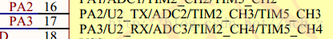
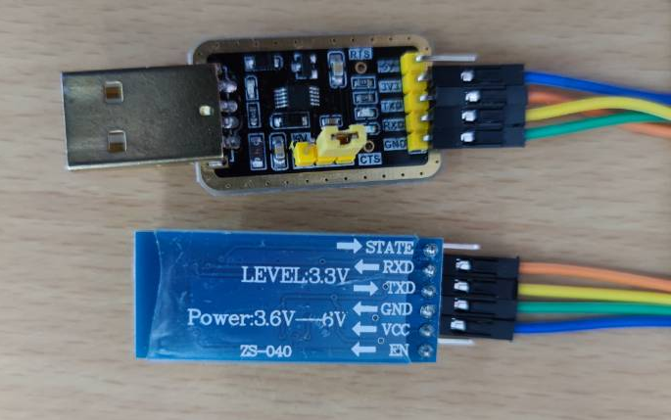

03
Bluetooth Module
HC-05 *2; Dupont lines; USB to TTL
Implementation method:
The sensor signal can be transmitted via a terminal with the same Bluetooth function.
Bluetooth module pairing
Stm32 and bluetooth
USART2 on THE STM32 board is selected to communicate with Bluetooth to know the connection mode through the STM32 schematic diagram.
2. Initialize the Bluetooth module
Set PIO11 to high.
Open the module, and the module will enter the AT command response state.
Use serial port tool to set the baud rate to 38400, data bit to 8, stop bit to 1, and parity bit to none.
The serial port sends the character "AT+ROLE=1\r\n", and returns "OK\r\n" on success, where \r\n is a carriage return character.
PIO set to low, re-POIR, module master module, automatic search slave module, establish connections.
b) USB to TTL and Bluetooth

Slide 14
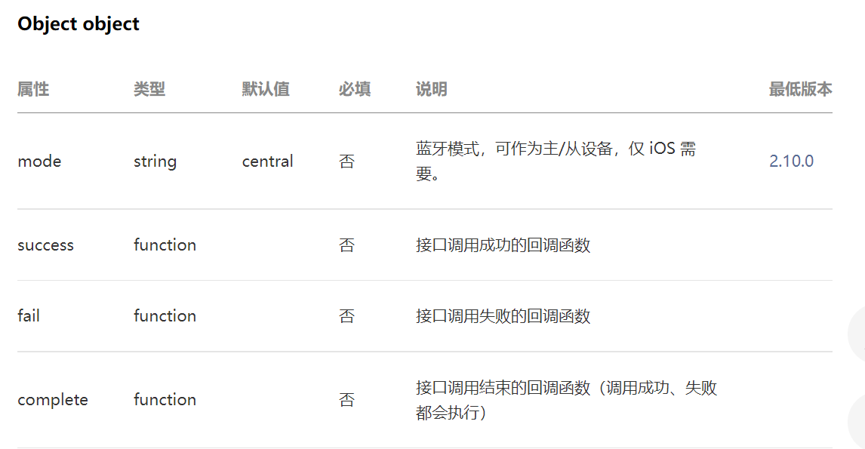
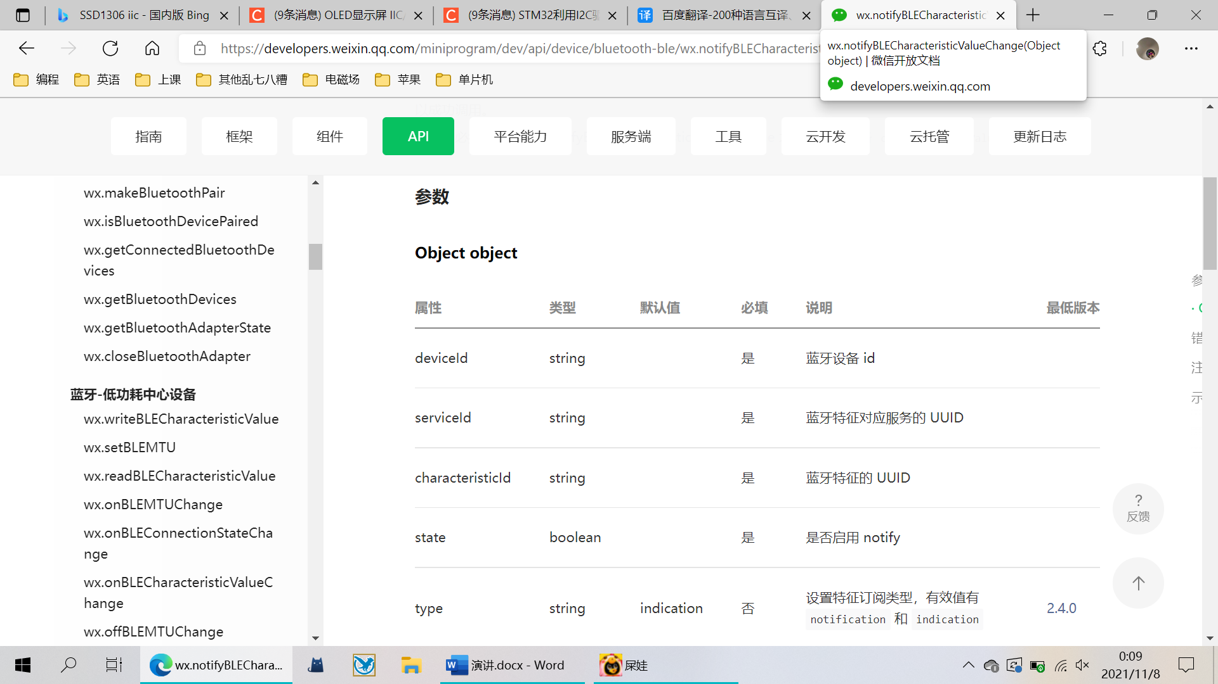
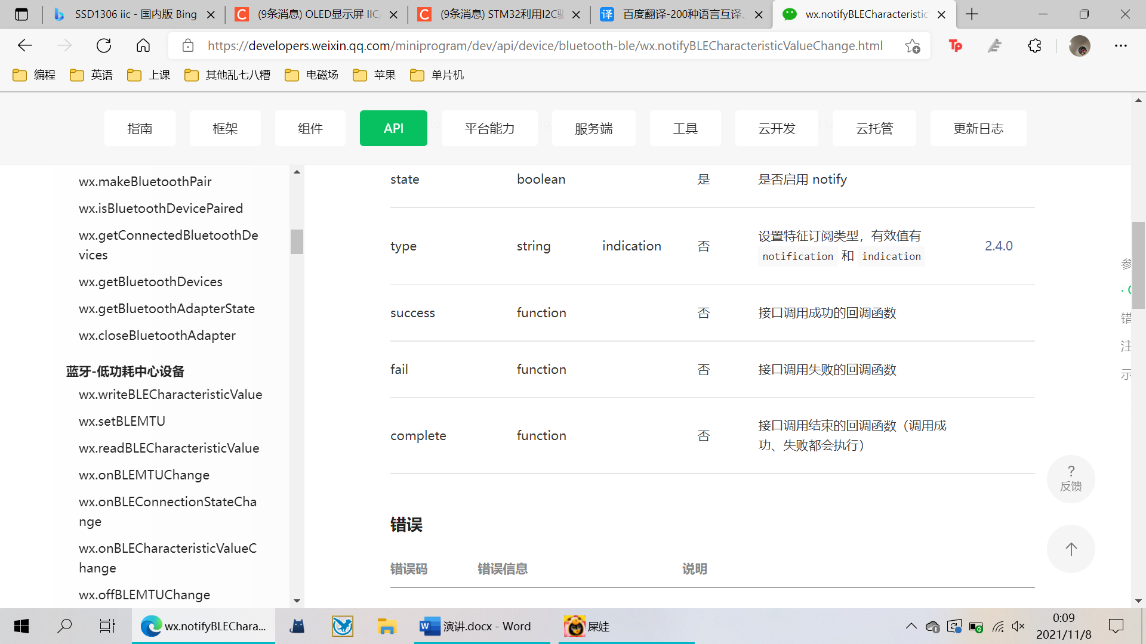
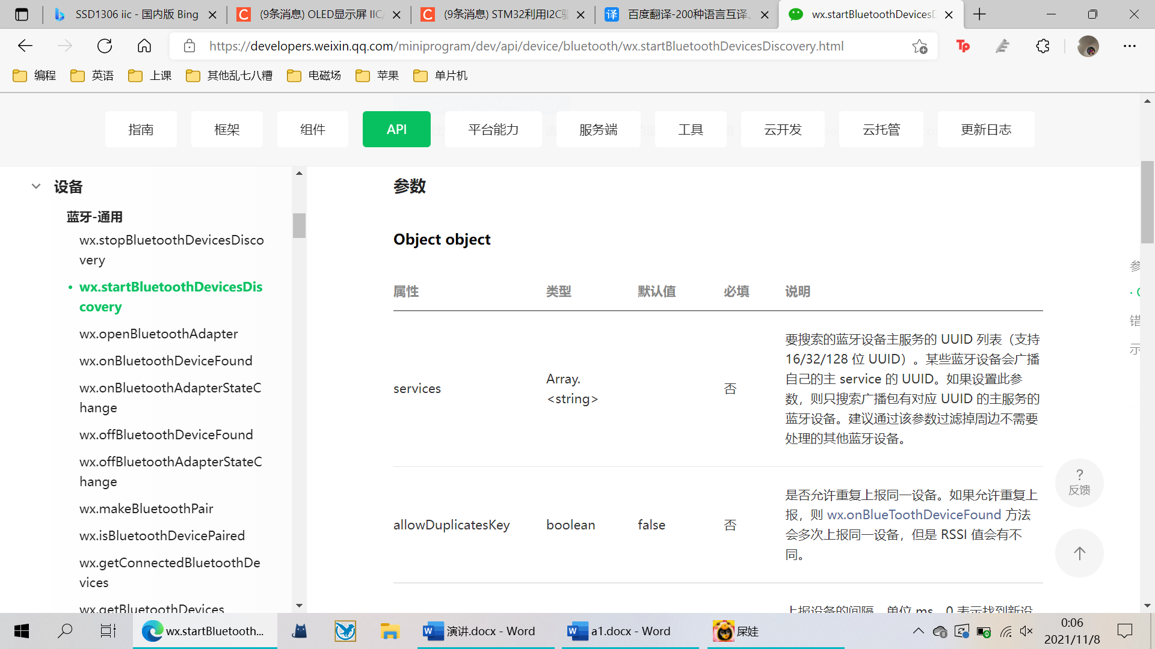
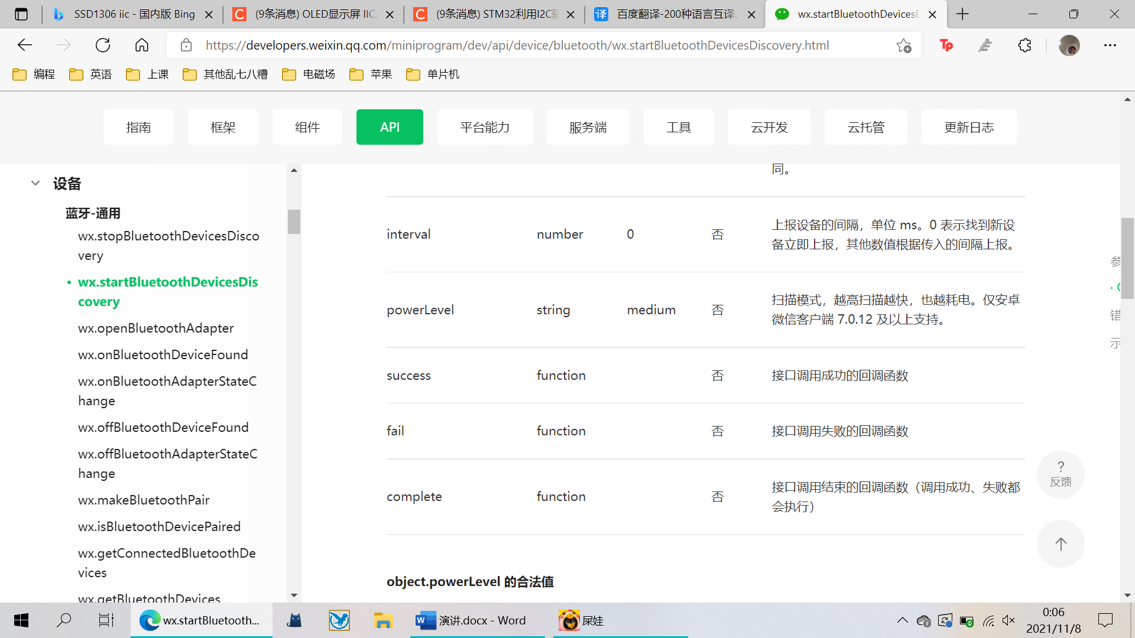
03
1 Initialize bluetooth
You need to initialize the Bluetooth module with wx.openBluetoothAdapter.To enable the host/slave (peripheral device) mode on iOS, you need to invoke the command once and specify the corresponding mode
APP Framwork
Develop wechat mini program to search bluetooth devices and connect them with mobile phones for data transmission.
2 Search for Bluetooth devices
With wx.StartBluetoothDevicesDiscover started to search for nearby Bluetooth peripheral devices.
3 Monitor bluetooth data
With wx. NotifyBLECharacteristicValueChange to monitor bluetooth data; Enable the notify function when the feature values of Bluetooth low-power devices change.

Slide 15
Dot matrix screen
& OLED screen

Slide 16
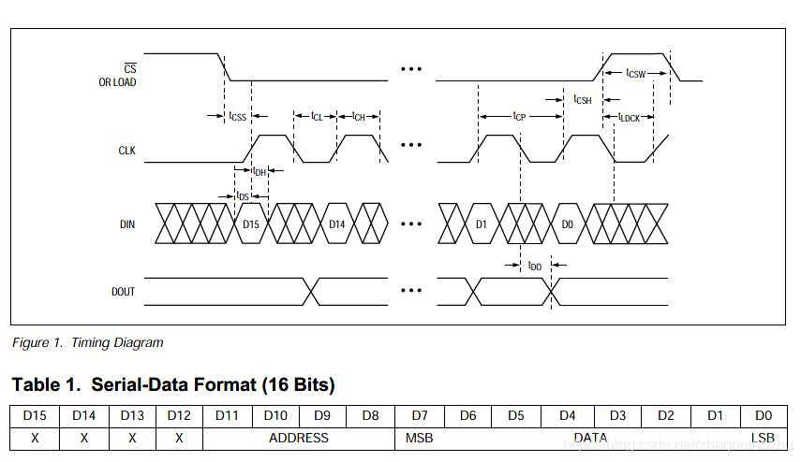
04
Dot Matrix Screen
Time display
1 Data interpretation
Max7219 and STM32 communication mode: MAX7219 communication mode is SPI, 16bit data format, high preposition.

Slide 17
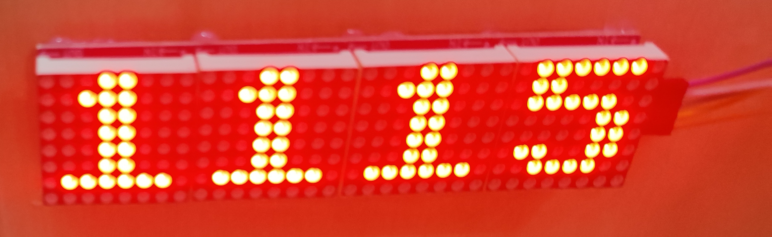
04
Dot Matrix Screen
Time display
Max7219 control mode: SPI sends 16bit at a time, that is, 2 bytes = address + data. Addresses represent different functions, and data represents parameters you want to set. According to the need to directly to the address table, and then according to the address function set data. The initial power-on is shutdown mode (table2 register table is the address).
Control an LED lattice (total cathode), dig0-DIG7 these eight pins need to be connected to the lattice of 8 cathode pins, the general chip DI0 pin is connected to the lattice of the first line of cathode pins, DIG1 is connected to the lattice of the second line of cathode pins...And so on. The SEGDP pin is connected to the first pin (high first) on the left of the lattice anode, and the SEGA-SEGG pin is connected to the lower seven pins on the back. So to make line 3 fully lit, write a number to address Digit2, this number is 0xFF(11111111b), then the DIG2 pin is pulled down, SEGDP, SEGA-SEGG are both high, and line 3 is fully lit. It is worth mentioning that when controlling the dot matrix, you need to set the chip to work in non-decoding mode, so that the data you write to digit0-DIGIT7 address is the LED bit lit in the corresponding position of your corresponding line. For example, if the data part is 0x00, a line is off and a line 0xFF is on.
The implementation step is, which point to control the digital tube address + want to display the data (can be set by decode mode BCD decode or not decode).

Slide 18
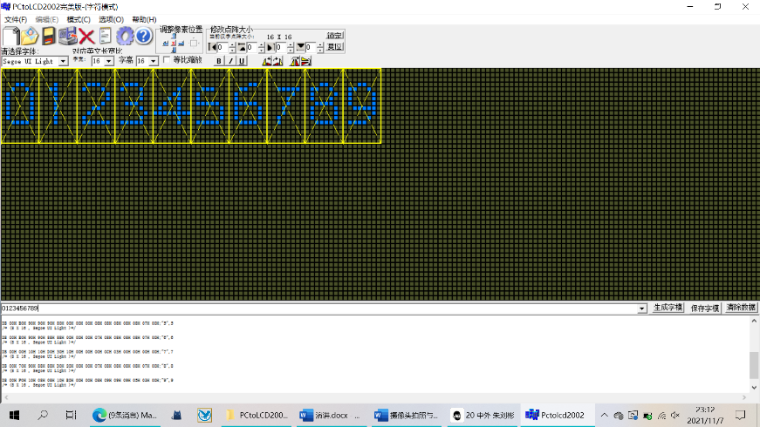
04
Dot Matrix Screen
Time display
2 Configure STM32 parameters
STM32 project is directly generated with STM32CubeMX, configure the RCC clock above, in order to display a variety of characters, so you need a character modeling software to generate the corresponding character logic code, the code is consistent with the logical position and logic level of LED lights. We use PCtoLCD2002 perfect version of the character mold software. Copy and paste the resulting character encoding into a static array variable in the program file, passing the variable into the display function as a parameter when used.

Slide 19
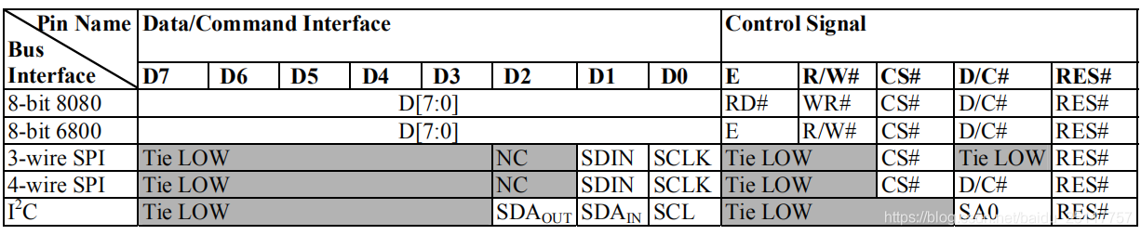
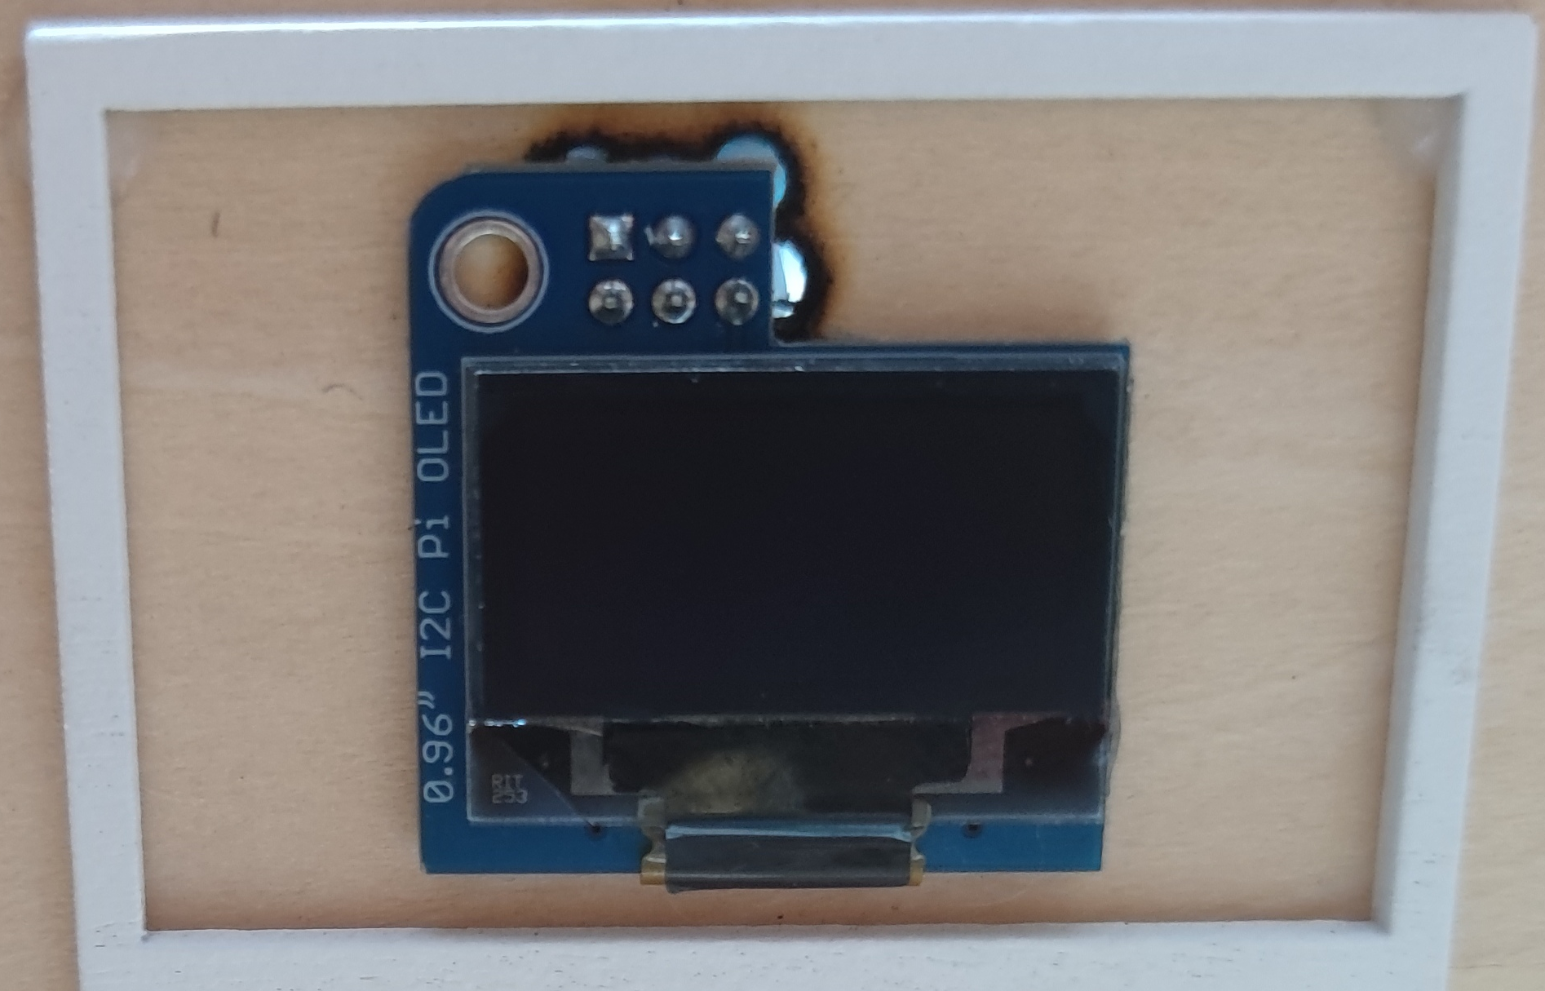
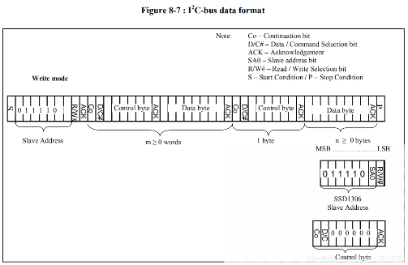
04
OLED Screen
Display sensor data
SSD1306 Writes data
The SSD1306 MCU interface contains 8 data pins and 5 control pins. The following table summarizes pin assignments for different interface modes. Different MCU modes can be set through the hardware selection on the BS [2:0] pins.
Write mode
1）The first is the initial state；
2）sent from the machine address: 0 x78 | (W/R), write to 0, read 1;
3）Waiting for a response;
4）Send control code: write data is 0x40, write command is 0x00;
5) Waiting for a response;
6）Send data values or command values;
7）Waiting for a response;
8）End state.
We also need to use the font conversion tool to generate
the corresponding character logic encoding

Slide 20
Camera monitoring & cloud platform storage

Slide 21
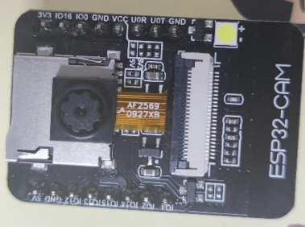
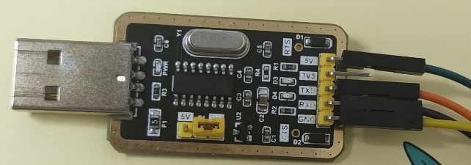
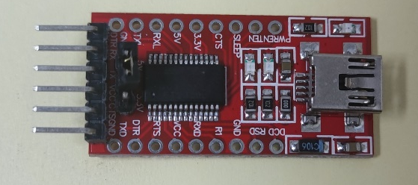
05
Camera monitoring & cloud platform storage
ESP32-CAM*2
Implemented functions：
Real-time monitoring
Upload a photo every 20 seconds to the Bava cloud platform for saving.
When mobile phone APP1 receives an alert, users can take photos through mobile phone App2.
View the pictures saved by Bava Cloud platform on the mobile phone APP3.
CH340G-USB to TTL *1
FTDI 232 module *1

Slide 22

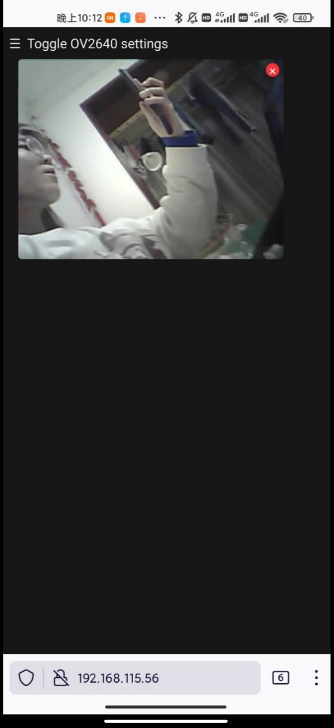

05
Camera one :
(esp32-cam + FTDI 232 module）
The functions realized:
1. After connecting with the camera to the same wifi (user name: KKKKKK, password: 12345678901), the dormitory can be monitored in real time through the web page (mobile phone or computer open http://192.168.115.56/).
2.When mobile phone App1 receives a warning of someone approaching, users can press OFF to take a picture through mobile phone App2 (Blynk) (the flash light of camera 1 will be turned on when taking a picture to ensure that the picture can be taken clearly even in the dark), and the picture can be saved and viewed through the website.

Slide 23
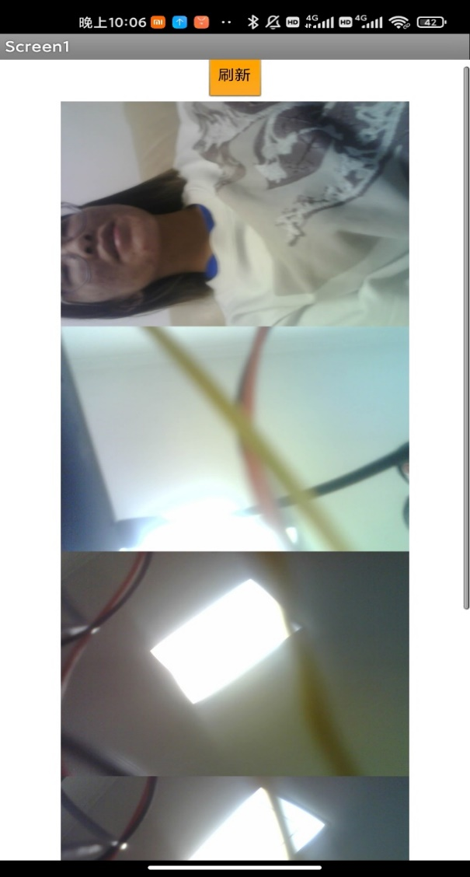

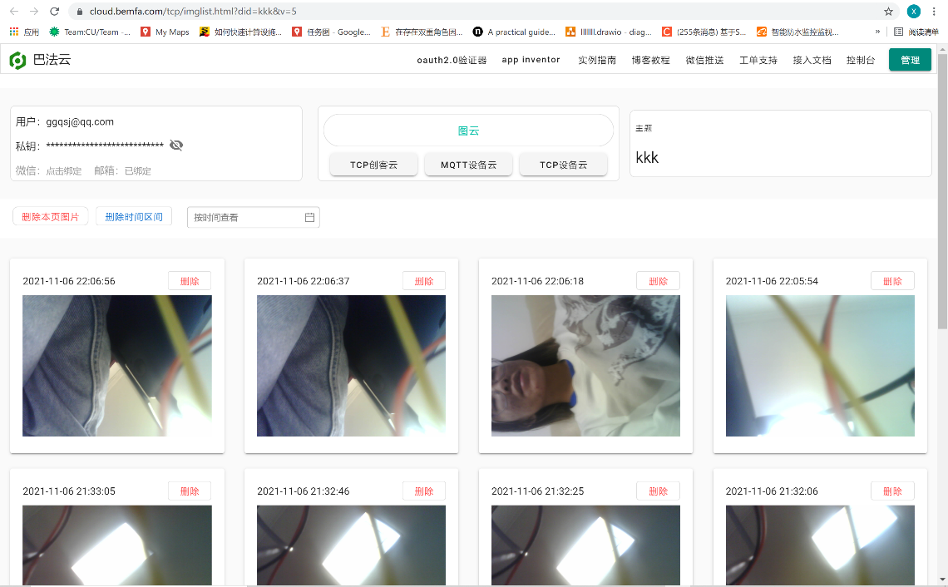
05
Camera two :
(esp32-cam + ch340g-usb to TTL）
2. View the pictures saved by Bava Cloud platform on the mobile phone APP3.
The functions realized are
1. Upload a photo every 20 seconds to the Bava cloud platform for saving.

Slide 24
Other modules

Slide 25
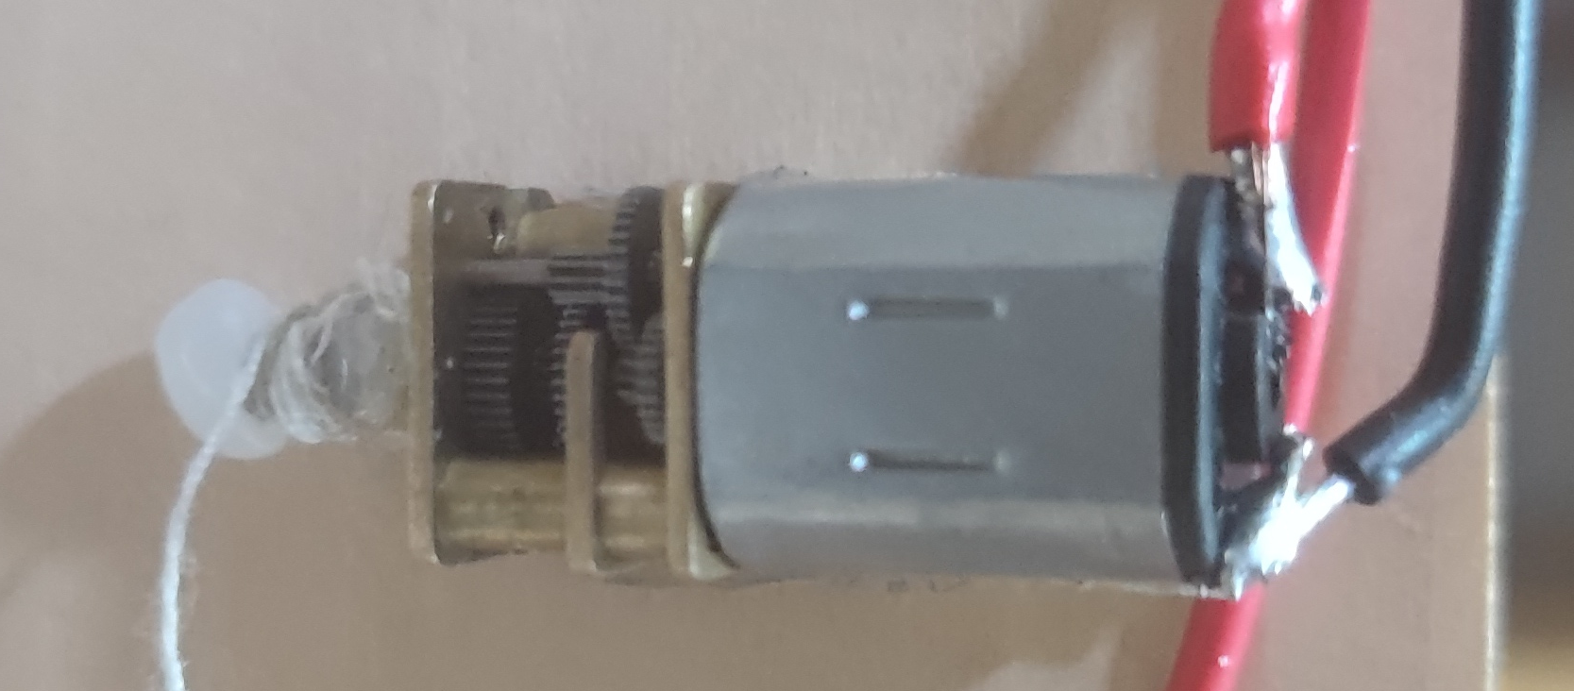
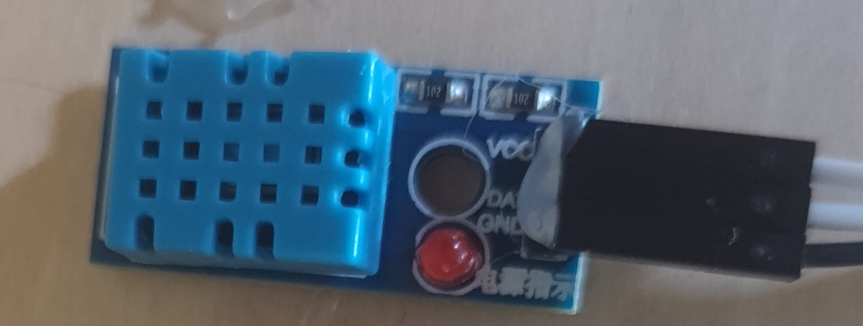
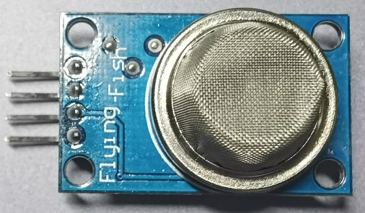
06
Other modules
The opening and closing of the door and curtain are controlled by the rotation Angle of the steering gear. The small fan is connected to the relay, and the voice module controls whether the relay is connected or not, and the relay controls whether the fan is opened or closed. When the steering gear is connected to the relay, turn 90 degrees clockwise to open the door, and turn 90 degrees counterclockwise to close the door. The steering wheel, which rotates 360 degrees, is connected to pulleys and rubber bands to control the opening and closing of curtains.
The DHT11 sensor is used to display the temperature and humidity. It adopts single-bus DATA format, and a complete DATA transmission is 40bit, with high first out. First the host sends the start signal first, and returns a corresponding signal from the opportunity to reply. Second pull the signal cable to the host to receive data. Then start receiving 40bit data. The output of 0 and 1 is similar in that they both first output the low level of 50 microseconds if the read signal is high, DHT11 is not responding, but the time of high level is different. Data bit 1 output high level longer than data bit 0.
Steering gear
Temperature and
humidity sensor
smoke concentration sensor
The smoke detection module uses MQ2 smoke sensor to detect the concentration of harmful gases, which can display real-time smoke concentration on the LCD board. When harmful gases exceed the limit, send out an alarm. Mq-2 can be used in home and factory gas leak monitoring devices, suitable for the detection of liquefied gas, butane, propane, methane, alcohol, smoke, etc. Its advantages are high sensitivity, fast response and good stability. Long life, simple driving circuit and easy installation.

Slide 26
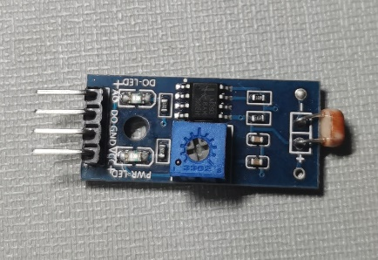
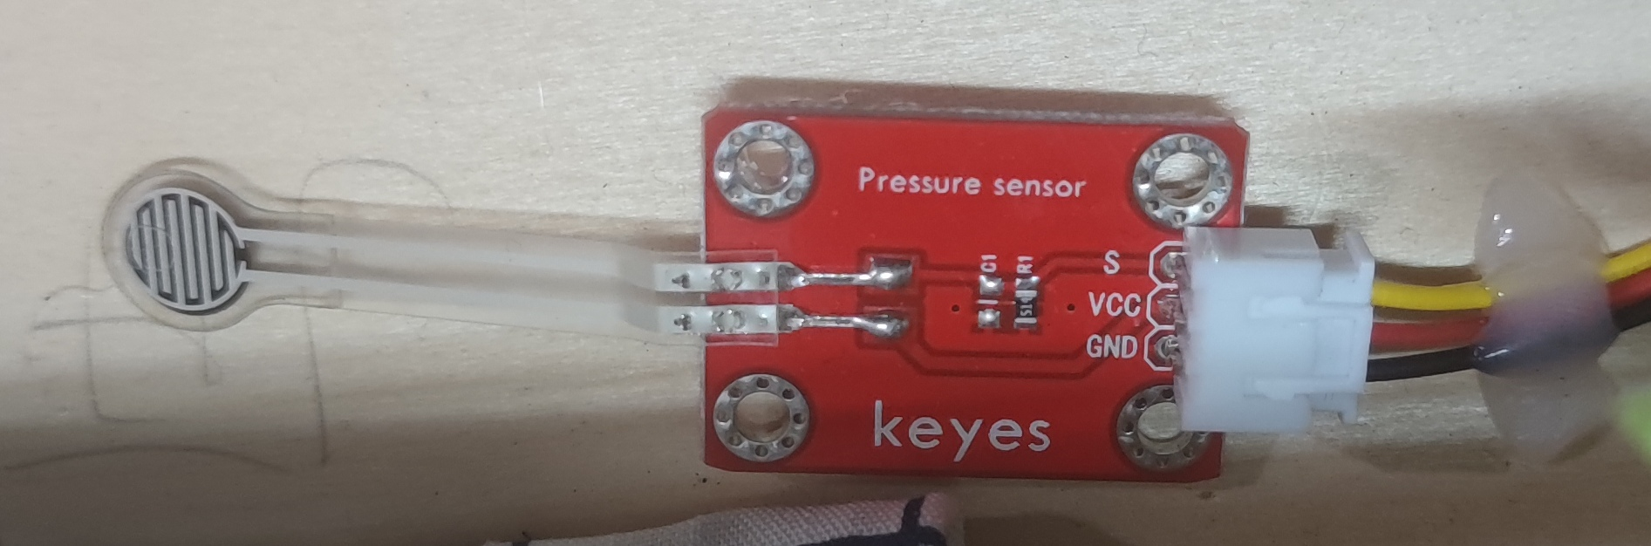
06
Other modules
photosensitive sensor
A photosensitive sensor is a sensor that uses a photosensitive element to convert a light signal into an electrical signal. When a reverse fixed pressure is applied to both ends of the photocell, any impact of light on it will cause it to release electrons. As a result, when The higher the light intensity, the greater the current of the photoelectric cell. When the current passes through a resistor, the voltage across the resistor is converted into a 0-5V voltage that can be received by the digital-to-analog converter of the collector, and then collected in an appropriate form The results are saved. The working principle of photoresistor: When light is illuminated, the resistance is very small; when there is no light, the resistance is very large. The stronger the light, the smaller the resistance; the light stops and the resistance returns to its original value.
Pressure film sensor
When you stretch or bend a piece of piezoelectric polyvinylidene fluoride PVDF polymer film (piezoelectric film), an electrical signal (charge or voltage) is generated between the surface of the upper and lower electrodes of the film, and the deformation is the same as stretching or bending. Proportionally. General piezoelectric materials are sensitive to pressure, but for piezoelectric films, when a small force is applied in the longitudinal direction, a large stress will be generated in the transverse direction, and if the same force is applied to a large area of the film, it will produce The stress will be much smaller. Piezoelectric film is very sensitive to dynamic stress. Because the charge generated by deformation will be lost from the circuit connected to the film, piezoelectric film cannot detect static stress.

Slide 27

07
division of labor
Yin Zhiyue:
1.Speech recognition & control module
2.Human infrared sensor & pressure sensor
3.Overall circuit connection
4.Overall program integration
Liu Junyi:
1.Record the progress on jira
2.Light-sensitive sensor module
3.Cabin model layout
4.Summarize PPT and presentation
Yu Wenlu:
1.APP back-end frame
2.Bluetooth module,
3.Dot matrix screen & OLED screen 4.Optimize the PPT
5
Ji Peilin:
1.Harmful gas sensor
2.APP interface design
3.Making the video
4.Overall program integration
Xie Lurui:
1.Temperature and humidity sensor 2.Camera real-time monitoring
3.Cloud platform storage
4.WIFI module
Liu Ruoting:
1.Ultrasonic distance measuring sensor
2.Fan part hardware design
3.Presentation
4.Making the video

Slide 28
Thank you for your time!
Team: Team 5
Team Member: Zhiyue Yin, Lurui Xie, Wenlu Yu, Peilin Ji,
Junyi Liu, Ruoting Liu

